Slide 1
Introduction
Lecture 1
Part 1
Generative AI for Computer Vision

Slide 2
Content
Computer Vision
Generative AI for Computer Vision
Challenges of Synthetic Data Generation
Applications of Generative AI for Vision

Slide 3
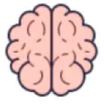

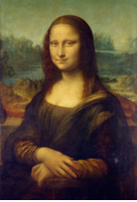
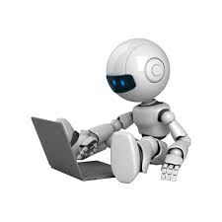

What is Computer Vision?
Interpretation:
Colour Image, Human, Lady,
Monalisa
Image Source: Internet

Slide 4
Generative AI: Definition
Generative AI
  Generative AI (GenAI) is a subset of artificial intelligence that creates new, original content—including text, images, code, audio, and video—by learning patterns from large amounts of existing data.
  Unlike traditional rule-based AI, Generative AI uses foundation models to generate human-like content, solve problems, and respond to user prompts.
  Its core technologies include Generative Adversarial Networks (GANs), Variational Autoencoders (VAEs), Large Language Models (LLMs), and diffusion models, which enable the creation of realistic and contextually relevant outputs.
Generative Modelling
  Generative modeling is an unsupervised learning task.
  Learns the patterns of input data from a given distribution to generate new examples which belong to the similar distribution.

Slide 5
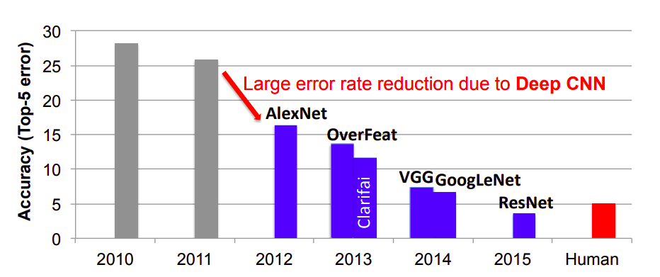
Why Gen AI is important?
In present day, deep learning has achieved a significant success in Supervised classification.
Figure: Top-5 classification error in test set - results from ImageNet challenge [1]
[1] Sze, Vivienne, et al. "Efficient processing of deep neural networks: A tutorial and survey." Proceedings of the IEEE 105.12 (2017): 2295-2329.

Slide 6
Synthetic Data Generation using Gen AI
It has been observed in the recent literature
  Deep learning models require large volumes of accurately annotated data for effective supervised learning.
  Model performance generally improves as the size, quality, and diversity of the annotated dataset increase.
Problem: Collecting and accurately labelling such large datasets is expensive, time-consuming, and often impractical for many real-world applications.
Solution: Synthetic data generation, powered by Generative AI (GenAI), is an emerging solution that creates realistic, labelled data at scale.
This reduces the dependence on manual data collection and annotation while improving model training and performance.

Slide 7
Generative AI for Computer Vision
Generative AI for computer vision is a rapidly advancing field that enables machines not only to analyze visual data but also to create new images, videos, and visual content.
Using deep learning models such as Generative Adversarial Networks (GANs), Variational Autoencoders (VAEs), and diffusion models, generative AI can generate realistic images, enhance image quality, perform image-to-image translation, and fill in missing visual information.
In computer vision applications, it is used for tasks such as data augmentation, image synthesis, super-resolution, object generation, and medical image reconstruction.

Slide 8
Generative AI for Computer Vision
By creating high-quality synthetic data, generative AI helps improve the accuracy and robustness of vision systems while reducing the need for large labeled datasets.
Its growing capabilities are transforming industries such as healthcare, autonomous driving, entertainment, and surveillance.

Slide 9
Challenges of Synthetic Data Generation
Generating realistic synthetic images remains a challenging task despite significant advances in generative AI.
One major challenge is achieving high visual fidelity while preserving fine details, textures, and natural lighting conditions.
Models may produce artifacts, distortions, or unrealistic features that reduce image quality.
Ensuring diversity in generated images is another difficulty, as models can suffer from mode collapse, where they generate limited variations of outputs.

Slide 10
Challenges of Synthetic Data Generation
Maintaining consistency in complex scenes, including object relationships, backgrounds, and perspectives, is also challenging.
Additionally, creating synthetic images that accurately represent real-world data without introducing bias requires large and diverse training datasets.
High computational costs, extensive training time, and concerns about ethical misuse, such as deepfakes and misinformation, further complicate the development and deployment of realistic image generation systems.

Slide 11
Applications of Generative AI for Vision
Generative AI has numerous applications in computer vision across various industries.
It is widely used for image synthesis, enabling the creation of realistic images from text descriptions or existing visual inputs.
In healthcare, generative models assist in medical image reconstruction, enhancement, and the generation of synthetic medical data for training diagnostic systems.
Data augmentation is another important application, where artificial images are created to improve the performance and robustness of computer vision models.

Slide 12
Applications of Generative AI for Vision
Generative AI is also used for image restoration tasks such as super-resolution, denoising, colorization, and inpainting.
In the entertainment and gaming industries, it helps generate realistic characters, environments, and visual effects.
Autonomous vehicles utilize synthetic data generation to train perception systems under diverse driving conditions.
Additionally, applications such as facial recognition improvement, virtual try-on systems, content creation, and digital twin development demonstrate the growing impact of generative AI in computer vision.

Slide 13
Summary
Computer Vision
Generative AI for Computer Vision
Challenges of Synthetic Data Generation
Applications of Generative AI for Vision

Slide 14
Discriminative vs. Generative Learning
Next
Lecture 1:Part 2
Generative AI for Computer Vision

